Slide 1
Toronto Traffic Collision Fatalities:
Machine Learning
University of Toronto
ML 3253
Amrin Krauss, Paul Soong, Sean Harrigan, Desola Odumuye

Slide 2
Problem statement

Slide 3
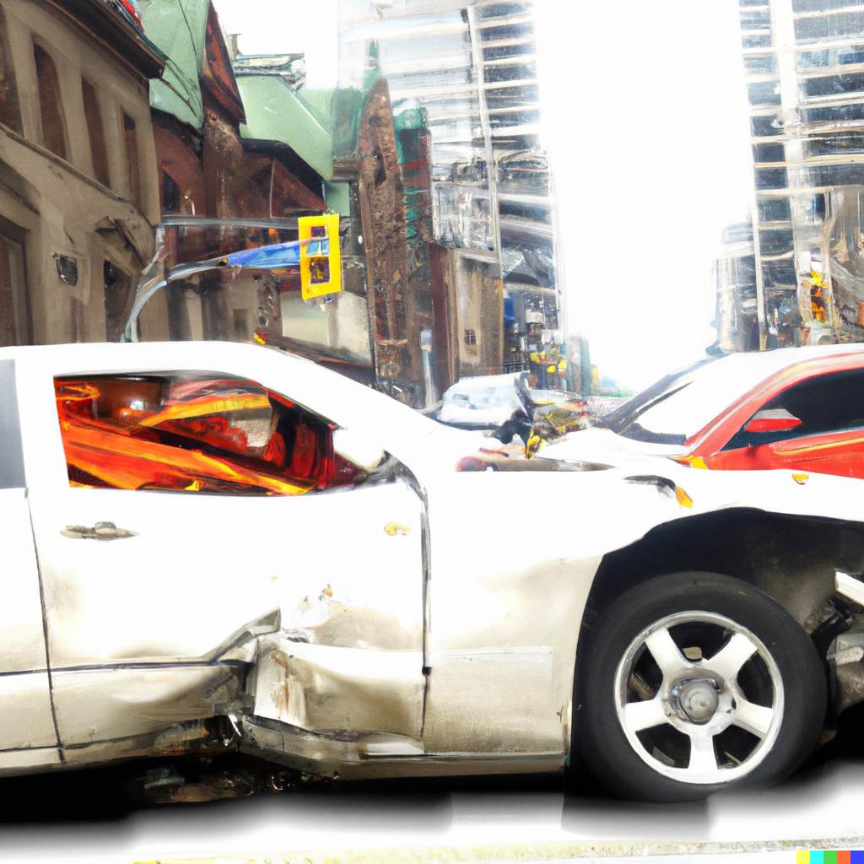
Background
Traffic collisions are one of the leading causes of injuries in Canada.
Fortunately, injury and mortality counts have been steadily decreasing over time with the introduction of new technology contributing to safer vehicles.
Despite these technological advances, traffic collisions still result in about 100,000 serious injuries per year, with over 1,500 deaths nation-wide (Statistics Canada).
Beyond the obvious impact on human health, traffic collisions also result in a large burden to the healthcare system as well as increased demand to first responders, and large costs inflicted on insurance companies and the legal system.
Images courtesy of DALL-E

Slide 4

Problem statement
Because of the serious impacts traffic collisions impose, cities would benefit from knowing which factors are associated with serious collisions as well as being able to predict if there will be a serious collision on a given day and if so how many.
The City of Toronto is the largest and most populous city in Canada, and would greatly benefit from being able to understand what factors are associated with serious collisions and how to predict when collisions may be more common in order to better allocate resources and promote safer driving and ultimately reduce injuries and fatalities.
Images courtesy of DALL-E

Slide 5
Aim
Our project will aim to predict if a traffic collision results in a fatality using the Toronto Police Traffic Collision dataset.

Slide 6
Methodology

Slide 7

Data
The data used for this project comes from the Toronto Police data portal
The Toronto police records all collisions that resulted in serious injury or fatalities
Killed or serious injury data (KSI)
This dataset captures all KSI data from 2006 to present, including a variety of different variables concerning the collision conditions and passengers involved

Slide 8
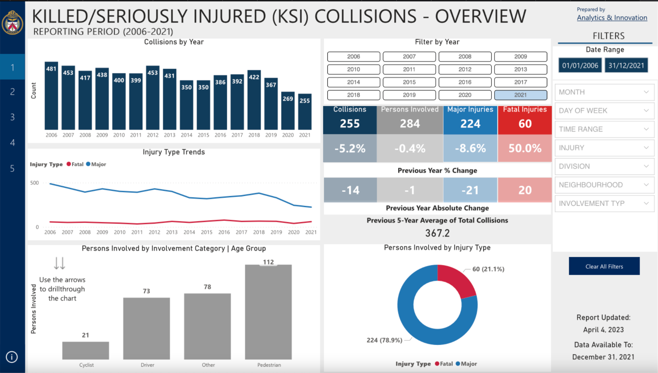

Slide 9
Data cleaning
The KSI data is collected at the individual-level data (an row for each individual involved in the collision)
We were interested in the collision-level data, as our problem statement was whether or not there was a fatality in any given collision
We therefore grouped the data based on the the unique identifier for collision and removed all individual level data.
The variables included in analysis are as follows:

Slide 10
Features, Instances and outcomes
Features: The features involved are collision-level features, which include data from the KSI dataset and a Ontario holidays dataset
→ Road type, visibility, impact type, pedestrian, cyclist, automobile, motorcycle, transit vehicle, truck, emergency vehicle, speeding, aggressive driving, red light, alcohol, disability, weekday, month
Instances: Each instance represents a collision. This could involve one or more cars as well as one more drivers/passengers/pedestrian or cyclist.
Outcome: Binary variable → whether or not there was a fatality a car collision.

Slide 11

ML Methodology
Train test split ratio of 70% to 30%.
Four ML algorithms:
Logistic regression
Decision Trees
Random Forest
KNN

Slide 12
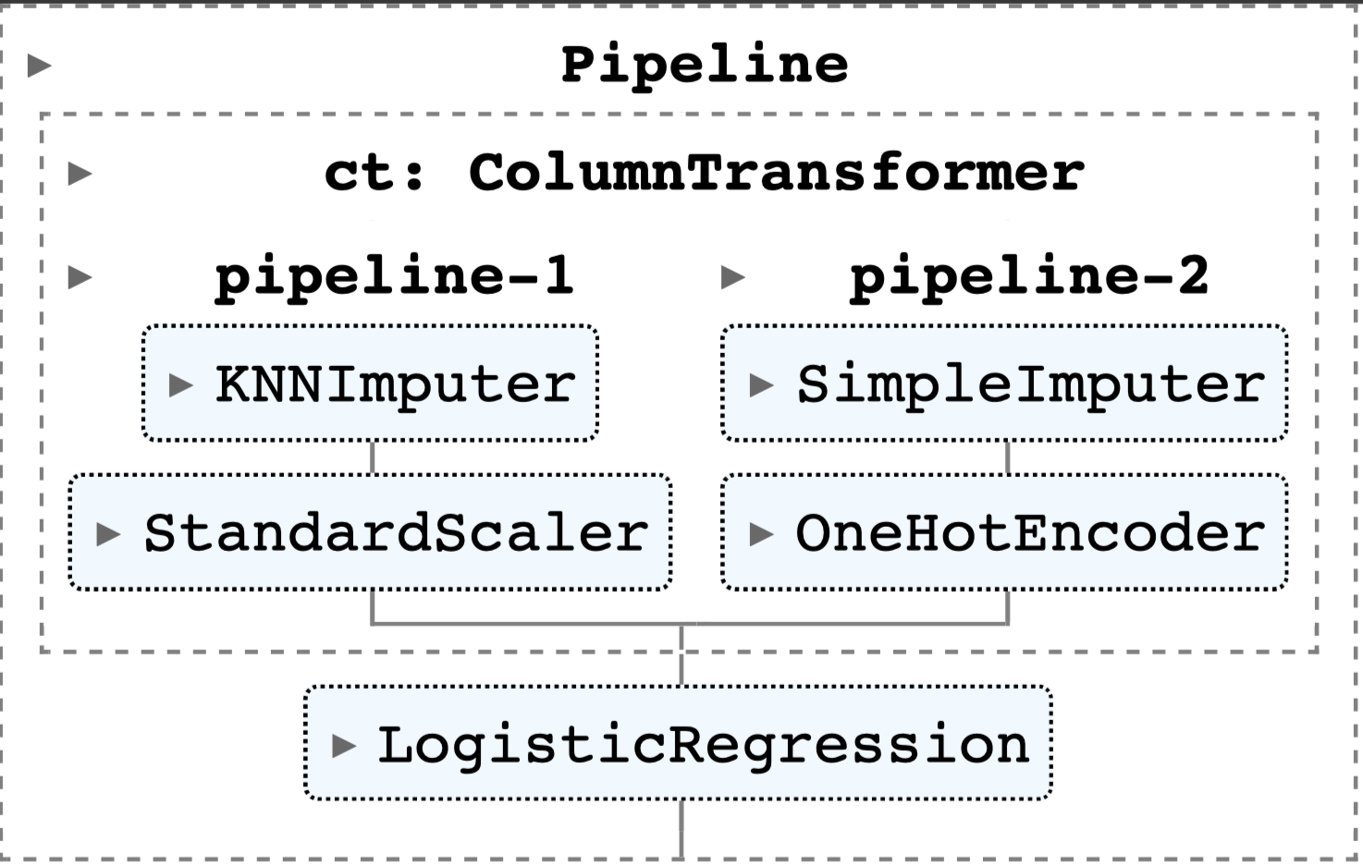
Pipeline
The image to the right is the pipeline used for all four ML algorithms
Pipeline-1: Numeric column transformers
Pipeline-2: Categorical column transformers
Logistic regression replaced by appropriate ML algorithm

Slide 13
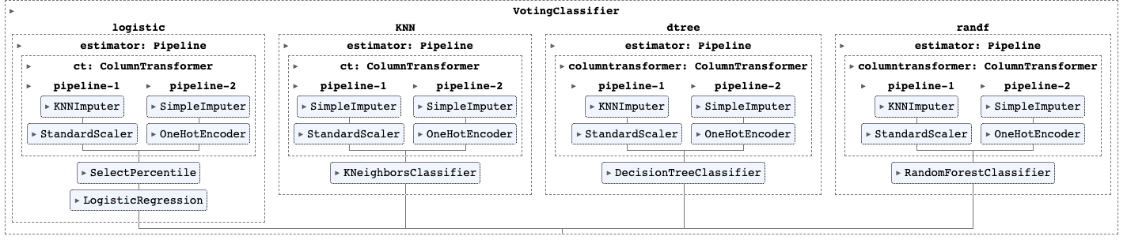
Voting classifier
Voting classifier using Soft voting, using all the previously mentioned algorithms and the best hyperparameters as per grid search

Slide 14
Hyperparameters
Hyperparameters were tuned for each pipeline via
GridSearchCV 10-fold cross validation
Hyperparameter | Values
Decision Tree
Criterion | Gini, Entropy
Max depth | 2, 4, 6, 8, 10, 12
Random Forest
N estimators | 90, 100, 115, 130
Criterion | Gini, Entropy
Max depth | range(2, 20)
Min samples leaf | range(1, 10)
Min samples split | range(2, 10)
Max features | Auto, Log2
Hyperparameter | Values
Logistics regression
Penalty | None, L1, L2, Elastic net
C | 100, 10, 1.0, 0.1, 0.01
KNN
n neighbours | 3, 5, 7, 9, 11, 13, 15, 17, 19
Weights | Uniform, Distance

Slide 15

Scoring metrics
Our dataset was imbalance in terms of the outcome and we therefore used the following scoring metrics:
AUC
Precision
Recall
F1
We will also adjust the probability threshold cutoff of 0.50 to see if we can improve these metrics. In doing so we are aiming to better capture fatalities in the dataset, by lowering the cutoff

Slide 16
Results

Slide 17
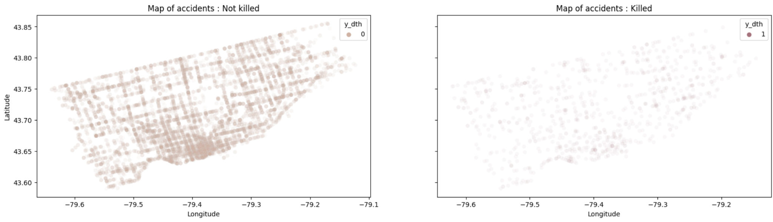
Exploratory analysis
Most collisions were centred around the downtown core of Toronto

Slide 18
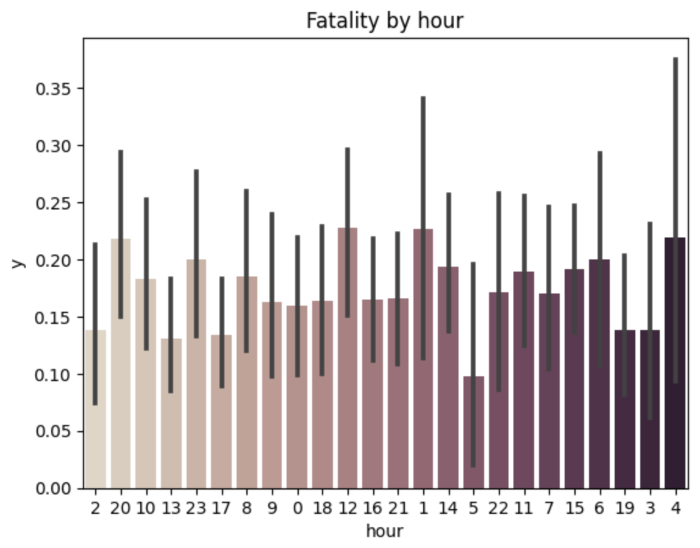
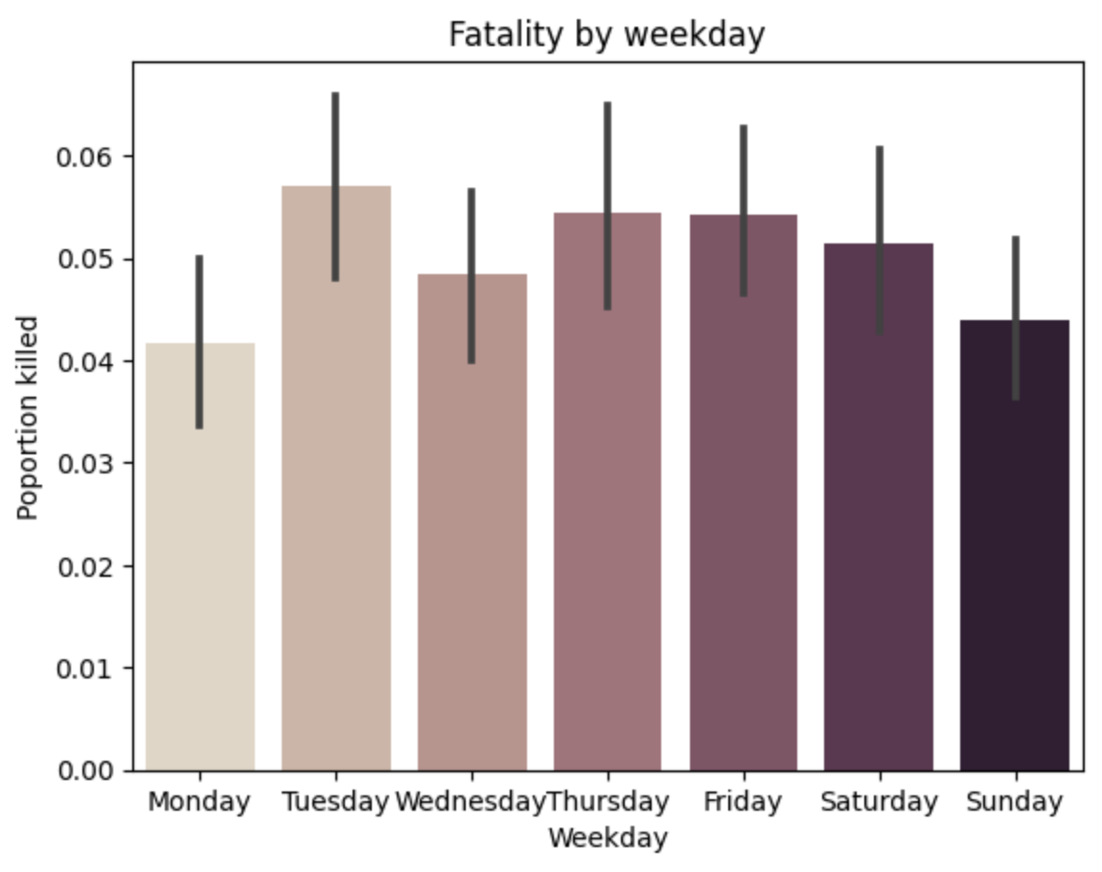
Exploratory analysis
Surprisingly, there was not obvious trends across the time and the day of the week

Slide 19
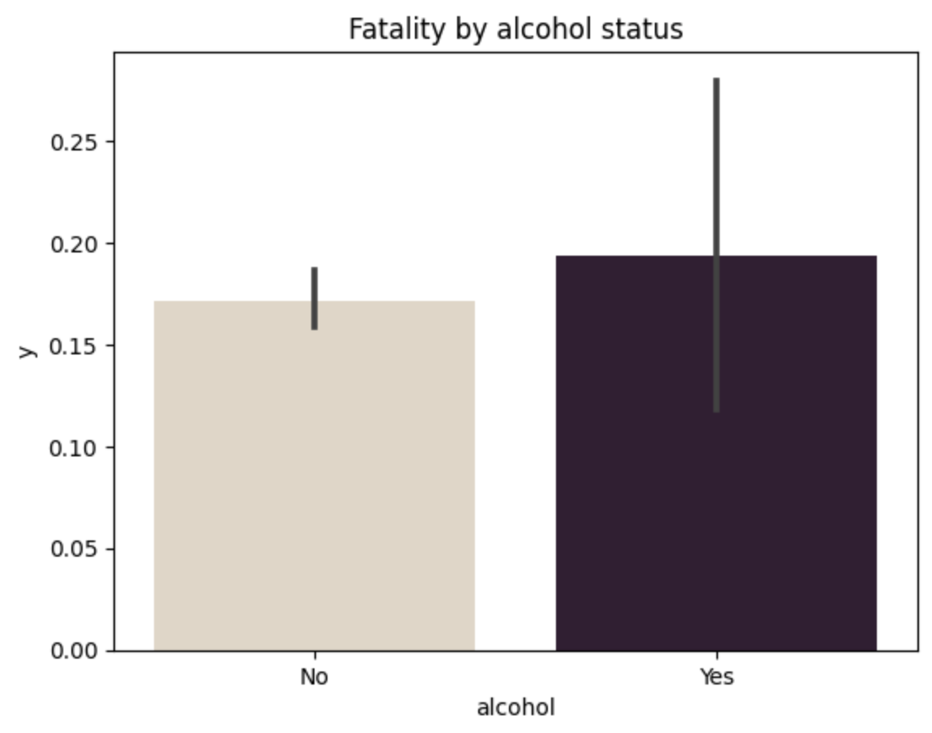
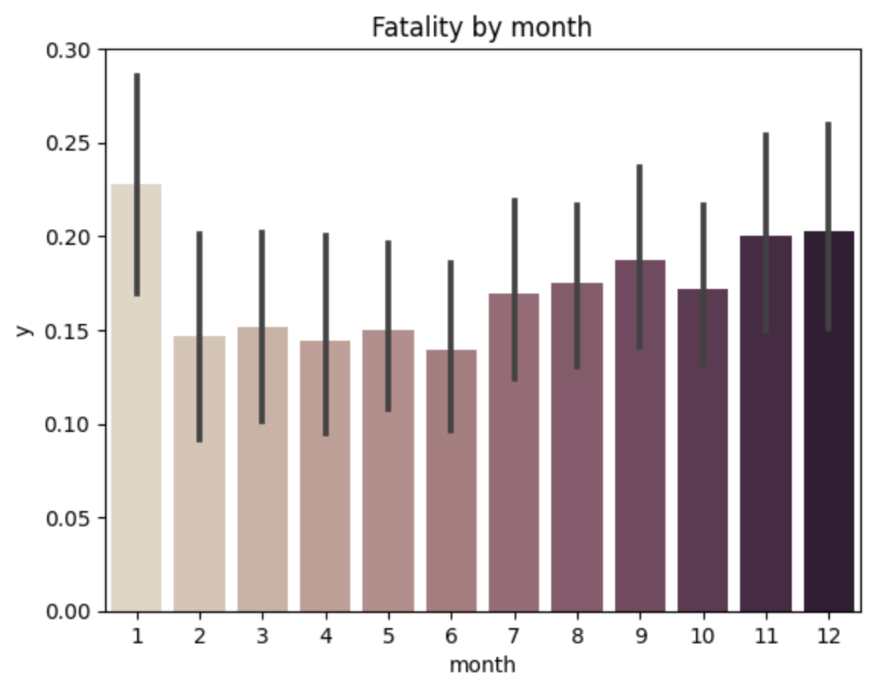
Exploratory analysis
This was also the case for other variables which we anticipated to be highly correlated with fatalities

Slide 20
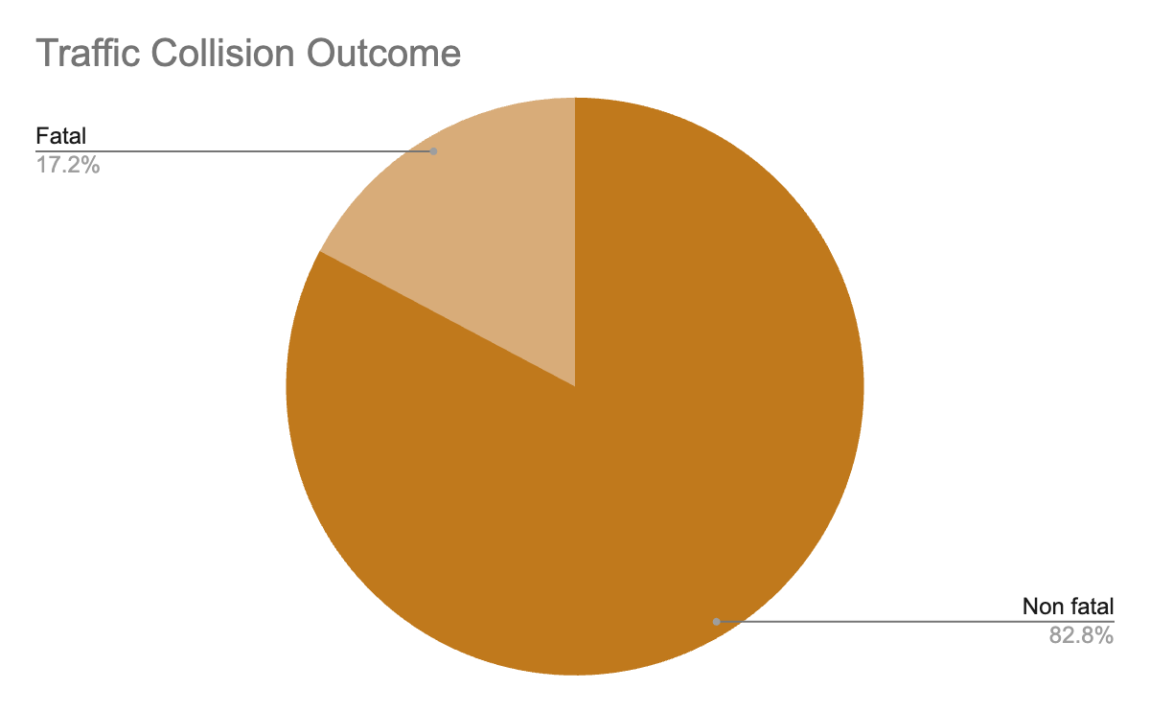
Machine Learning results
We filtered the dataset to only include collisions after 2014
There were large differences in reporting before 2014
2,791 instances
481 fatalities
Imbalanced dataset
Train size = 1,953
Test size = 838

Slide 21
Hyperparameters
After using grid search to tune hyperparameters, the following are the parameters chosen for each of the corresponding algorithms
Hyperparameter | Values
Decision Tree
Criterion | Gini
Max depth | 2
Random Forest
N estimators | 115
Criterion | Entropy
Max depth | 8
Min samples leaf | 1
Min samples split | 7
Max features | Auto
Hyperparameter | Values
Logistics regression
Penalty | L2
C | 0.1
KNN
n neighbours | 15
Weights | Uniform

Slide 22
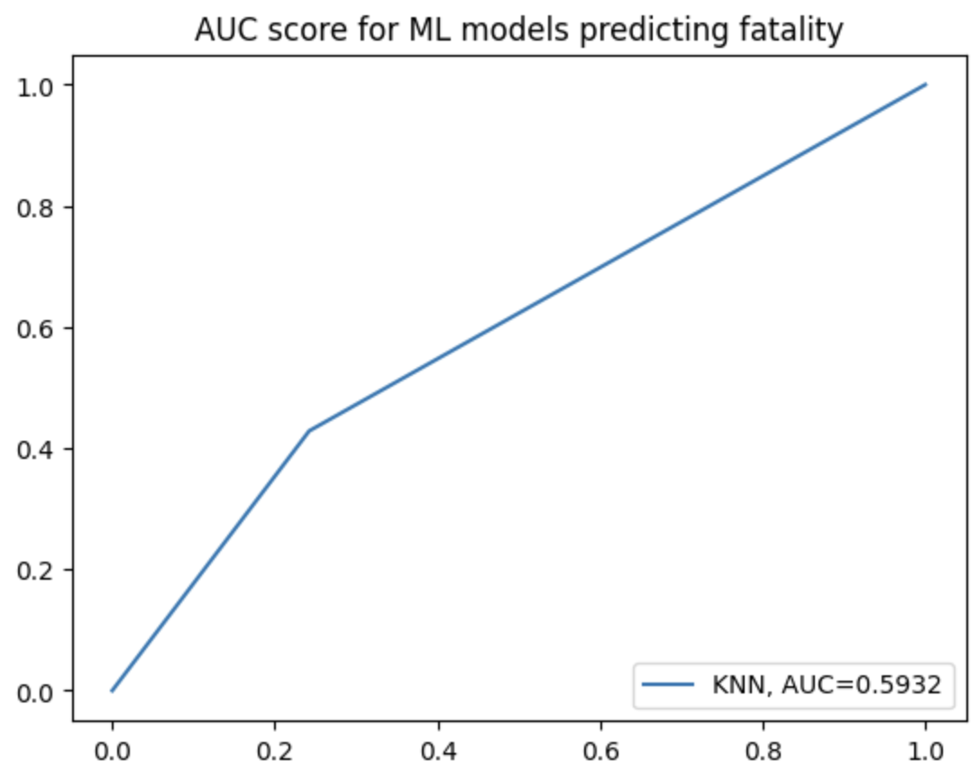
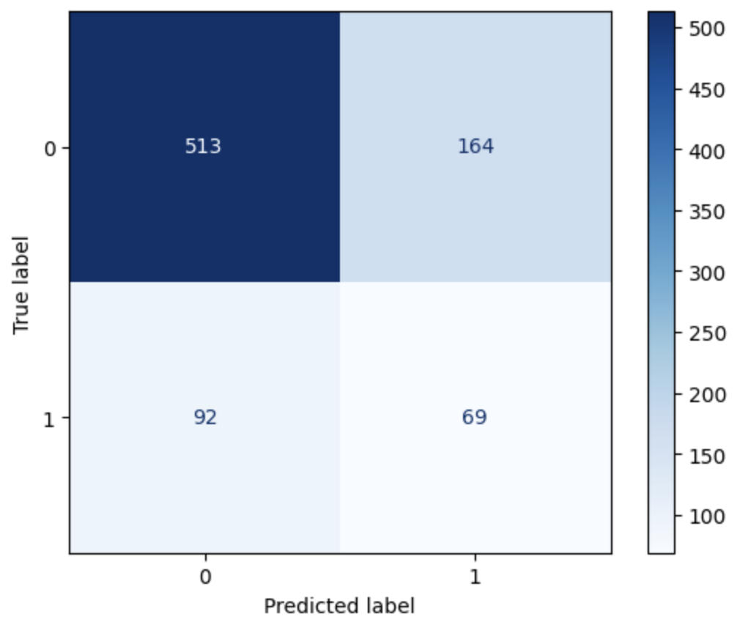
Scoring metrics
We used a probability threshold cut-off of 0.25 to try to improve out precision and recall. We also felt that it was important to capture more potential fatalities
Our best scoring model was the KNN model
AUC = 0.59
This was compared to the train AUC of 0.66, suggesting our model is slightly overfit

Slide 23
Precision, recall, F1
Our model had difficulty in being able to predict positive cases (fatalities)
Overall metrics:
Precision = 0.296
Recall = 0.429
F1 = 0.35
More detailed precision-recall scores can be seen to the right by outcome class
 | Precision | Recall | F1-score
Non-fatal | 0.85 | 0.76 | 0.80
Fatal | 0.30 | 0.43 | 0.35
Recall:
The number of fatality predictions made out of all fatalities
Precision:
The number of fatality predictions that actually belong to the fatality class

Slide 24
Discussion

Slide 25
Interpretation
Unfortunately we were not able to achieve relatively high precision and recall
This may be due to a number of reason:
This dataset only included collisions involving death or serious injuries
The difference between the two of these may be marginal in many cases and it may be difficult to predict this
For instance, what may have resulted in fatality for one individual may not for another
Since we grouped by car incident, we lose person-level data
This means we lose variables like age, which may be a very important variable in terms of predicting fatality, as younger children or older adults may have higher probability of fatality

Slide 26
Interpretation
Unfortunately we were unable to achieve relatively high precision and recall
This may be due to a number of reason:
We also noticed in our exploratory analysis that there were not any obvious trends in variables like month, day, alcohol etc.
We had hypothesised that these would be large factors (i.e. weekends, snowy months, etc.)
Ultimately, the smallest of things could affect accident severity, which the dataset was not able to pick up
Seatbelt use, angle of collision, age of car, age of airbags, whether breaks were applied before collision, underlying injuries to people involved
The time it takes for first responders to arrive on seen also would have a large impact
Since these are all serious accidents, the amount of time it takes for paramedics to arrive on seen could be the difference between life or death

Slide 27
Lessons learned

Slide 28
What we learned
Car incidents are by nature often random events and although severity of injuries can be related to certain factors, the severity of the incidents is hard to predict
Real world data is much harder to find patterns in than the toy datasets often practice with
Ultimately, being able to find patterns in data is linked directly to the availability of data recorded.
In the case of our project, there were not enough features that were tightly linked to severity as anticipated
The features in this dataset may have likely been better suited to predicting the number of incidents (serious or not) as opposed to incident severity.

Slide 29
Thank you!

